Slide 1
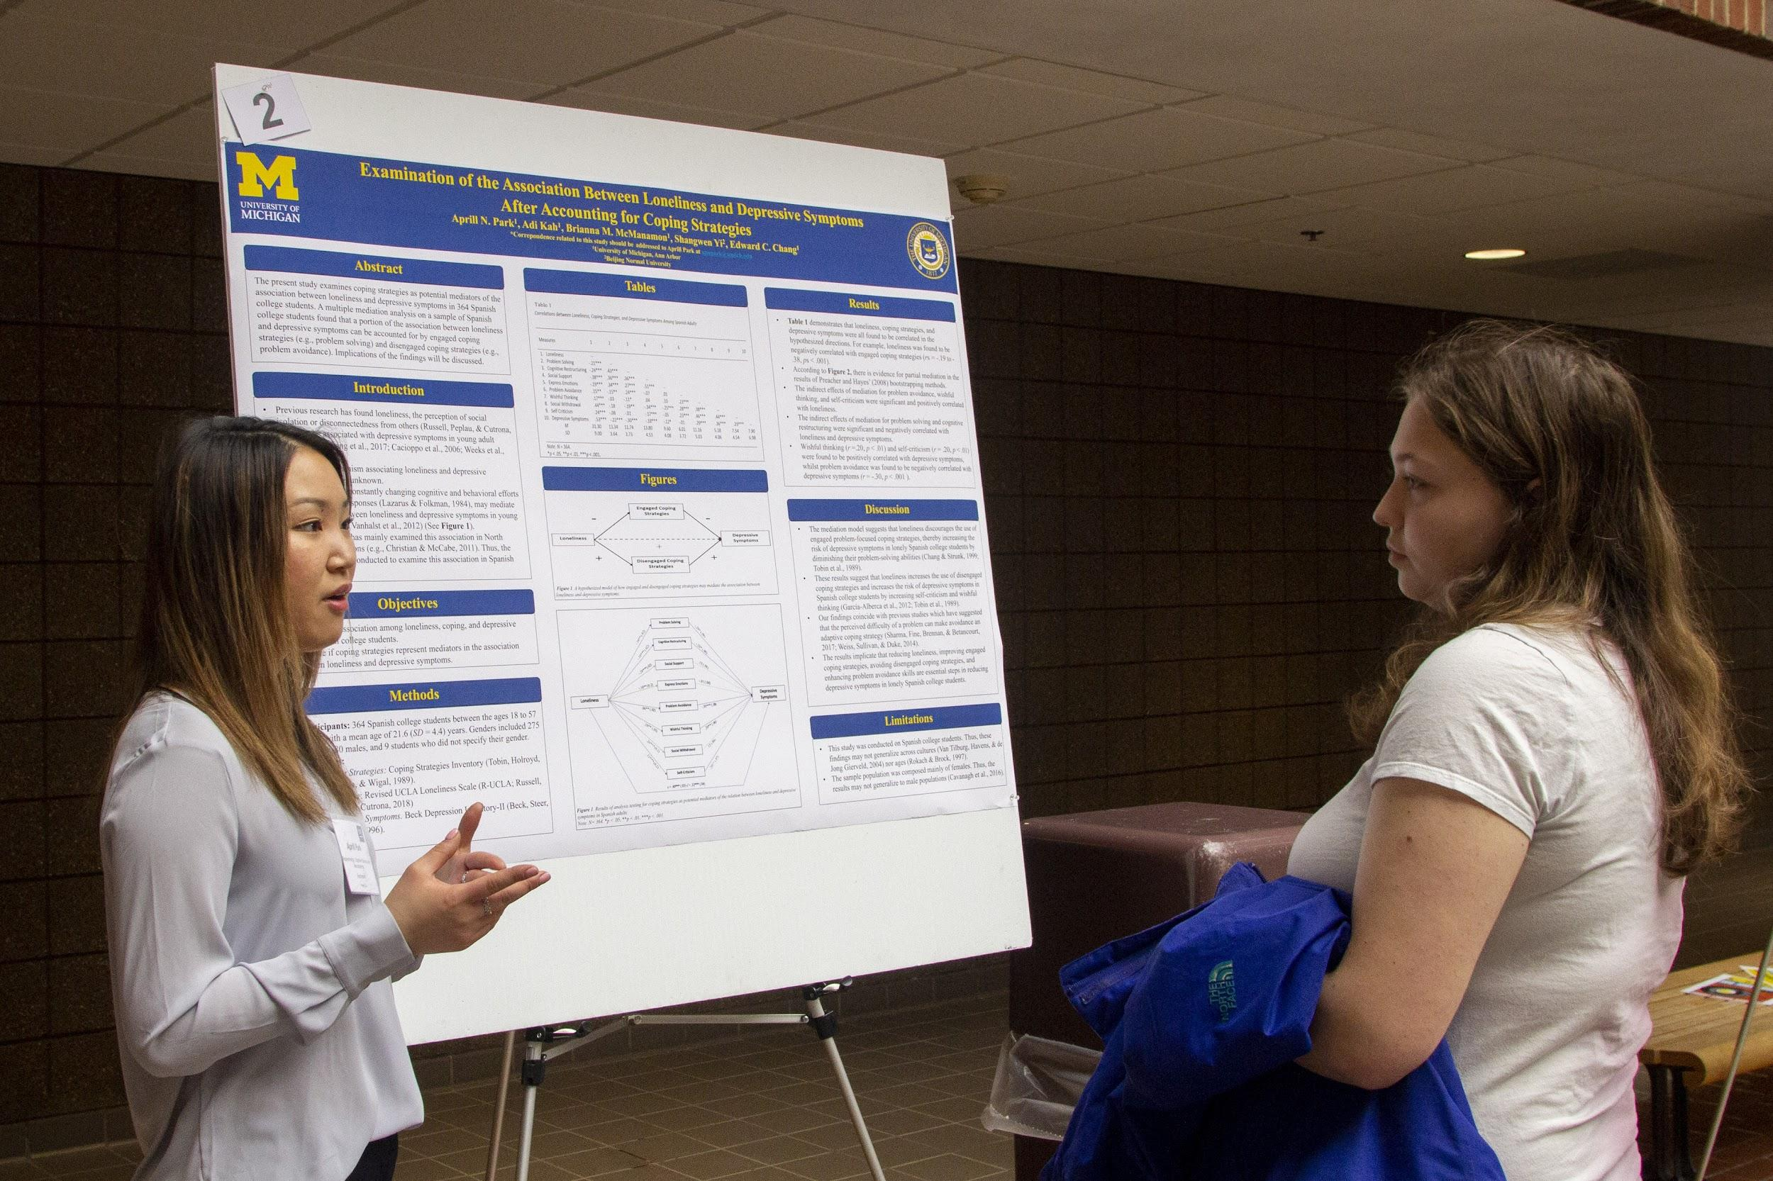
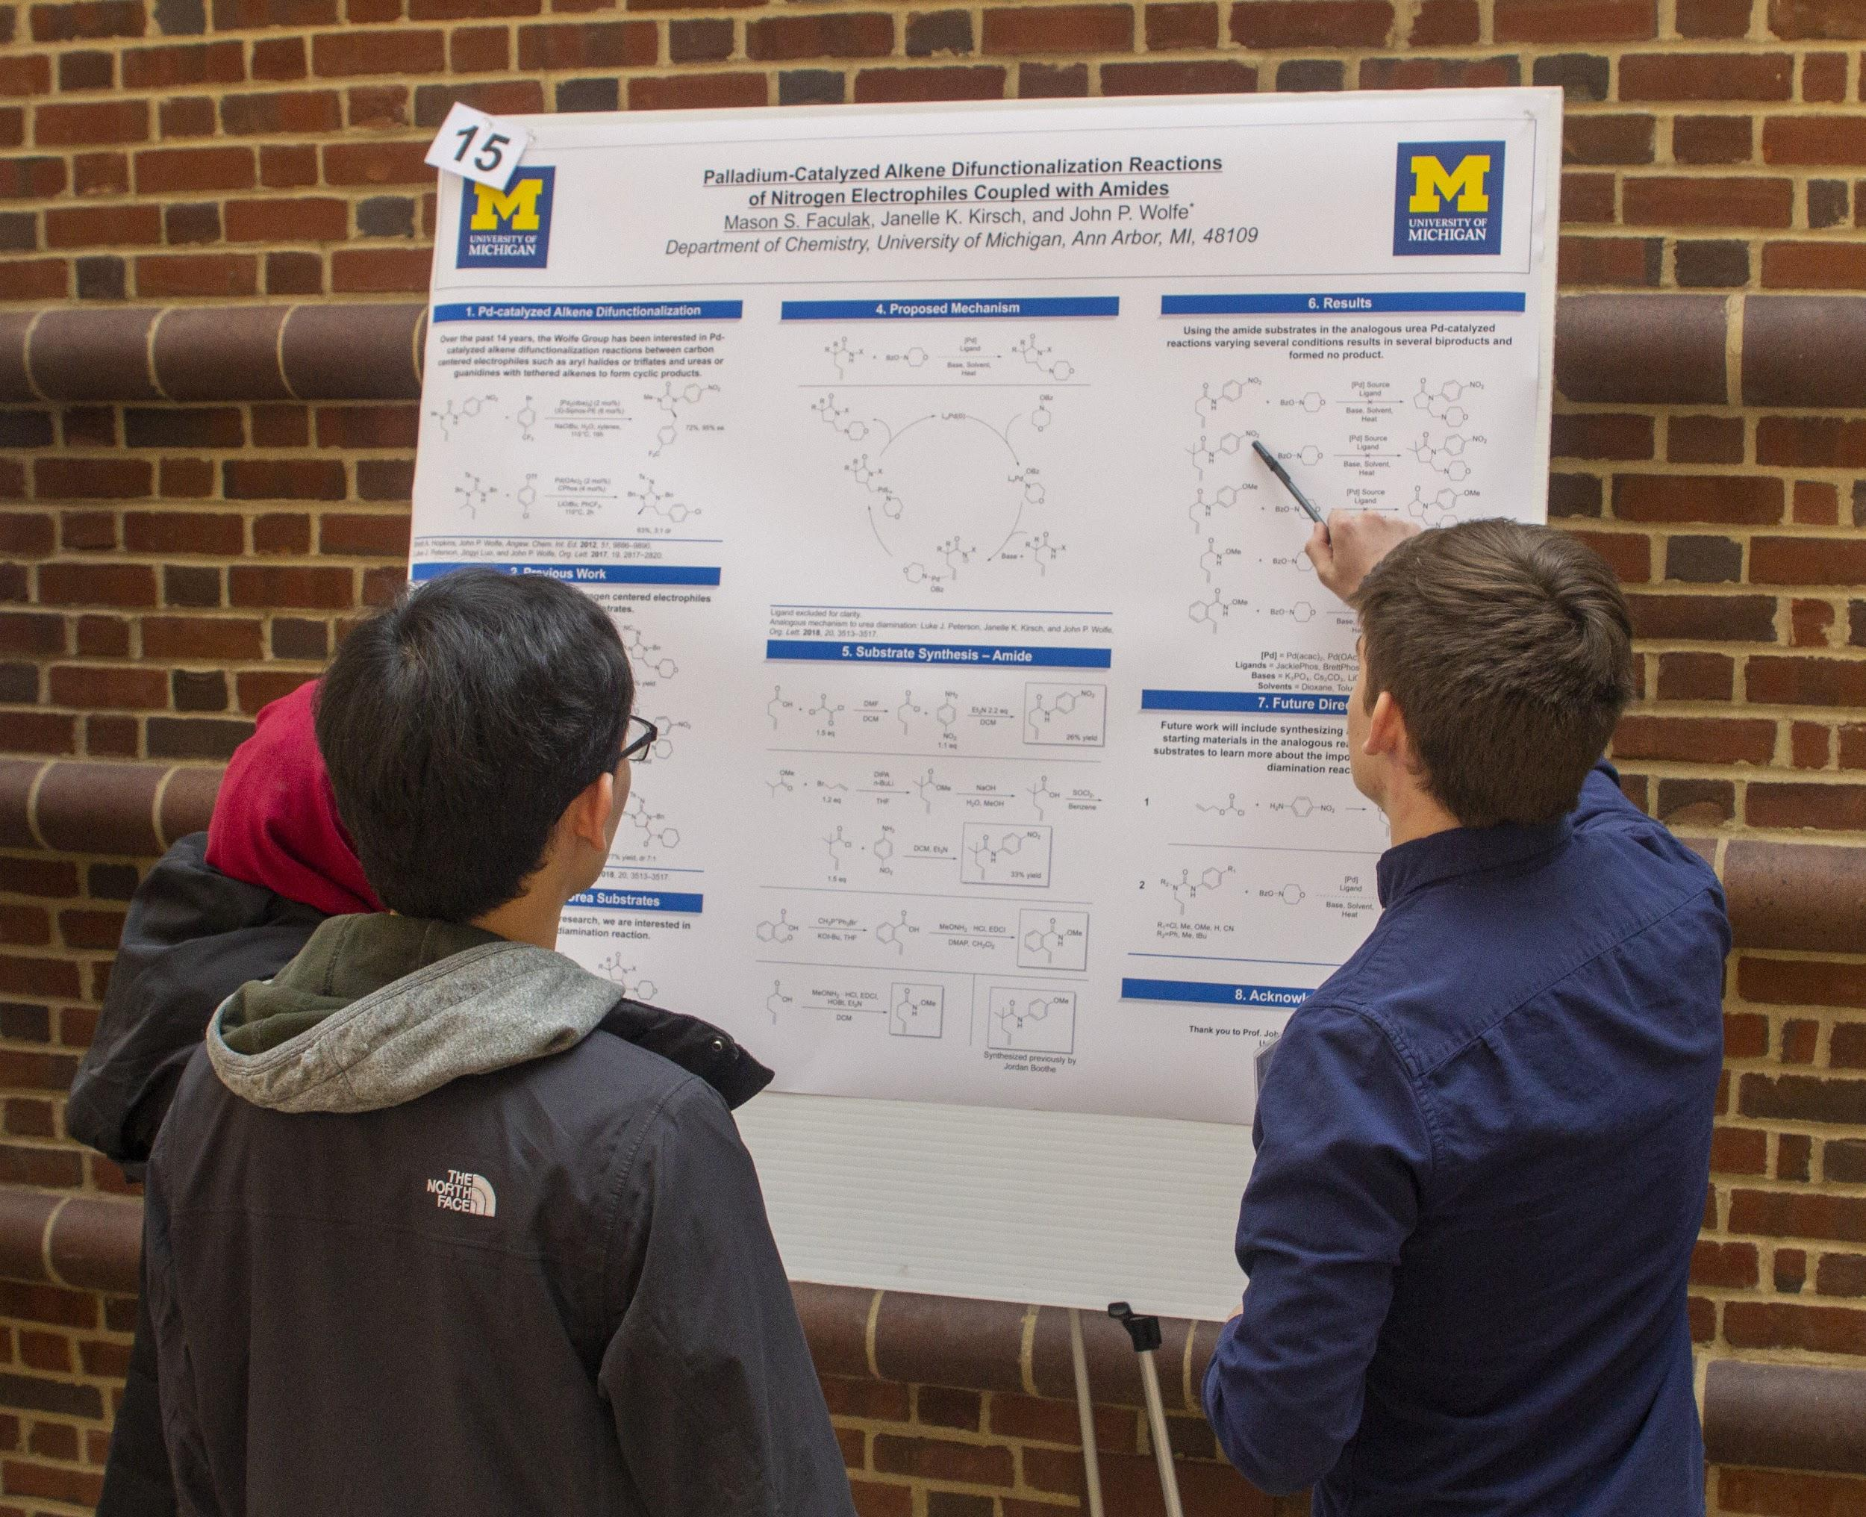
Research Resources
Presented by Undergraduate Research Symposium
Notes:
**All underlined bullet points are hyperlinked to their website for more information!

Slide 2
General
Department Emails
After declaring a major/minor you are subscribed to a departmental email with information about opportunities and events
Be Proactive! Talk with Department Advisors about opportunities
Office of Research at UM Dearborn
Office of Research at UM Flint
UROP
Undergraduate Research Opportunity Program
UM Library Resource
The library has a great source of information on research opportunities and funding - these cover the Internal and external
How to Navigate UM Websites
A great place to check is the Websites of possible Colleges/Departments the typical track is Undergraduates > Research > (Funding/Resources)

Slide 3
Departmental Funding
(Not all Departments offer funding or compensating but here are some examples)
History Department
Travel/Research refund $600 domestic travel, $900 international travel
Anthropology Department
Research Grants - Biannual funding given out to support research. Soonest Deadline: March 9th, 2022; Stipend $1,000
Riggs Hoenecke Undergrad Experience Prize to support, internships, fieldwork, and research. Deadline: March 9th, 2022; Stipend: 1st year $1,000; 2nd year $2,000; 3rd year $3,000
Sociology
Sociology Undergraduate Research Opportunity Program: Connects sociology majors with various research opportunities
Sociology Thesis funding $400; Sociology Experimental Funding $300 (Program Suspended during COVID)
Notes:
Discontinued: STAMPS
Undergraduate Student Research Grants; $2,000 for students building on their STAMPS experience and portfolio

Slide 4
UM Dearborn Scholarships
Undergraduate Student Independent Research
Provides $500 for independent research projects conducted by Dearborn undergrads
Project must be part of a course for credit and supervised by a faculty member
Due to COVID-19, these programs might still be suspended, so check with the office of research at DBN-Research@umich.edu
Notes:
Discontinued:
Undergraduate Research Fellowship: Provides up to 3 awards each funding cycle of $2,750 each to hire a student to assist full-time faculty members with work on summer research and projects done not for credit
Student Conference Presentation
For travel expenses and/or presentation materials for regional and national symposiums to present research done at UM-Dearborn

Slide 5
UM Dearborn Scholarships
CASL Student Faculty Mentored Research Scholarship
Ask financial aid office for more info
Due March 1 for the following year
Dr. Paul Zitzewitz Memorial Scholarship for Student Research
Award used to purchase supplies, presentation materials, provide travel aid, etc. for students who are majoring and conducting research in the natural sciences
Typically due March 1 for the following year
Roger F. and Norma J. Verhey Math Education Scholarship
Preference will be given to students who are majoring, or intend to major, in Mathematics.
John J. Brownfain Endowed Memorial Honors Scholarship
Supports students majoring in Psychology or any majors that are part of the Literature, Philosophy, and the Arts or the Language, Culture, and Communication departments
Comprehensive list of funding (both internal and external)

Slide 6
UM Flint Scholarships
Student Research Endowed Funds
Funds will support expenses including research supplies, human subject incentives, and conference registration fee or conference travel expenses
Awards up to $500 per academic year
Scholarships include: Beatrice and William Caldwell Research Fund, UM-Club of Greater Flint Research Award, Gerald and Sharon Schreiber Research Fund, Harry and Wanda Piper CAS Undergraduate Research Fund
Faculty (like your research advisor) can also apply for funding which they can then use to fund your projects
Comprehensive list of funding (both internal and external)

Slide 7
UM Summer Research Programs
LSA Honors Summer Fellowship - Due February 11th; Stipend: $6,000
This opportunity is open to 3rd years in LSA that will/are a declared Honors Major (different from the LSA Honors Program) where they take residence in Ann Arbor to complete a thesis proposal
UROP Summer Programs
Many programs in different fields looking for UM undergrads from diverse backgrounds
Engineering Summer Research Fellowship - Due February 25th; Stipend: $4,000
Funding to do cutting-edge research in: Electrical Engineering, Material Science and Engineering, Computer Engineering, Physics, Chemistry and Chemical Engineering
Biomedical & Life Sciences Summer Fellowship - Due February 25th; Stipend: $4,000
A 10-week fellowship for intensive research in Biomedical & Life Sciences
Detroit Community-Engaged Research Program
Research projects addressing social and environmental justice, food insecurity, human rights, public health, youth development, and more!
Typically due mid January; Stipend: $2,500
And More!

Slide 8
UM Summer Research Programs Cont.
Summer Undergraduate Research in Engineering
10-12 week program working with UM faculty on an array of disciplines
Typically due mid January; Stipend: $5,000; open to 2nd year and 3rd year students
Departmental Summer Fellowships
UM Dearborn: Summer Undergraduate Research Experience (SURE) Program - Due March 11th
Work with a faculty advisor and attend different Lunch & Learn sessions about different topics in research
Each student receives a stipend of $3,500 and presents at the SURE Project Showcase
UM Flint: Summer Undergraduate Research Experience (SURE) Program
Full or half-time paid summer research opportunities mentored by UM-Flint faculty advisors

Slide 9
National Summer Research Programs
NSF REU (National Science Foundation Research Experience for Undergraduates)
STEM related REU sites (not at UM) where undergraduates participate in research
Deadline: January/February 2022
Amgen Scholar - Due February 1st
STEM research opportunity at 1 of 17 universities around the world
Funding varies by institution;
UM Smart - Due January 31st
Research relevant to human disease under a faculty mentor at UM for 10 weeks
Stipend: $4,400
NIH - Due March 1st
National Institute of Health Internship program for 8 weeks researching a biomedical field
Funding provided by individual scientist

Slide 10
UM STEM Research Career Awards
U-M STEM Research Career Award - UM Deadline: December-January
Available for UM sophomores and juniors
$5000 scholarship for summer research or other academic expenses
Application and letters of recommendation will also be used to select U-M’s nominees for the Goldwater and Astronaut Scholarships from among eligible applicants
Goldwater
National grant aimed at 3rd/4th years that are leaders in mathematics, engineering, and natural sciences
Award Max. $7,500;
Astronaut
National grant that promotes STEM researchers (2nd/3rd years)
Award Max. $15,000;
Contact Henry Dyson for more information

Slide 11
Tips for applying to programs
Who is this program intended for?
Level of experience
Year
Background
How will this program will benefit you?
More than being interested, demonstrate that this program will provide you with a unique experience that they could not get elsewhere
Pay attention to the goals/funding sources of the program
e.g. NSF supports researchers, not medical doctors
For writing applications
Don’t just list accomplishments - show how they and this program fall in line with your future goals
COVID - Don’t focus on what you could not do, but what you did do despite challenges
Letters of Rec should come from someone who knows you and your motivations

Slide 12
Q&A

